Slide 1
Design Patterns

Slide 2
background knowledge
Relations Between objects:
Association
Dependency
Composition
Aggregation
SOFTWARE DESIGN PRINCIPLES
Encapsulate What Varies
Program to an Interface, not an Implementation
Favor Composition Over Inheritance
SOLID Principles
Single Responsibility Principle
Open/Close Principle
Liskov Substitution Principle
Interface Segregation Principle
Dependency Inversion Principle

Slide 3
background knowledge
Relations Between objects:
Association
Dependency
Composition
Aggregation
SOFTWARE DESIGN PRINCIPLES
Encapsulate What Varies
Program to an Interface, not an Implementation
Favor Composition Over Inheritance
SOLID Principles
Single Responsibility Principle
Open/Close Principle
Liskov Substitution Principle
Interface Segregation Principle
Dependency Inversion Principle

Slide 4
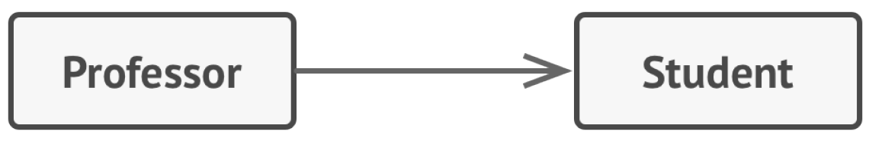
Relations Between objects
Association
proffesor communicates with students;
like a field in a class;

Slide 5
background knowledge
Relations Between objects:
Association
Dependency
Composition
Aggregation
SOFTWARE DESIGN PRINCIPLES
Encapsulate What Varies
Program to an Interface, not an Implementation
Favor Composition Over Inheritance
SOLID Principles
Single Responsibility Principle
Open/Close Principle
Liskov Substitution Principle
Interface Segregation Principle
Dependency Inversion Principle

Slide 6
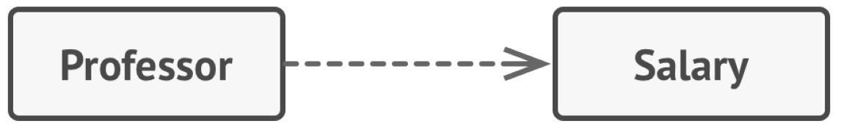
Relations Between objects
Dependency
proffessor depends on salary;
is a weaker variant of association that usually, implies that there’s no permanent link between objects;
you can spot a dependency between classes: a dependency exists between two classes if changes to the definition of one class result in modifications in another class;

Slide 7
background knowledge
Relations Between objects:
Association
Dependency
Composition
Aggregation
SOFTWARE DESIGN PRINCIPLES
Encapsulate What Varies
Program to an Interface, not an Implementation
Favor Composition Over Inheritance
SOLID Principles
Single Responsibility Principle
Open/Close Principle
Liskov Substitution Principle
Interface Segregation Principle
Dependency Inversion Principle

Slide 8

Relations Between objects
Composition
university consists of departments;
an object composed of one or more instances of the other class;
the distinction between this relation and others is that the component can only exist as a part of the container.

Slide 9
background knowledge
Relations Between objects:
Association
Dependency
Composition
Aggregation
SOFTWARE DESIGN PRINCIPLES
Encapsulate What Varies
Program to an Interface, not an Implementation
Favor Composition Over Inheritance
SOLID Principles
Single Responsibility Principle
Open/Close Principle
Liskov Substitution Principle
Interface Segregation Principle
Dependency Inversion Principle

Slide 10
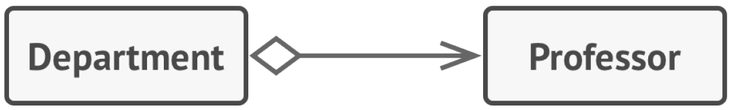
Relations Between objects
Aggregation
departments contains professors;
is a less strict variant of composition, where one object merely contains a reference to another.
the container doesn’t control the life cycle of the component

Slide 11
background knowledge
Relations Between objects:
Association
Dependency
Composition
Aggregation
SOFTWARE DESIGN PRINCIPLES
Encapsulate What Varies
Program to an Interface, not an Implementation
Favor Composition Over Inheritance
SOLID Principles
Single Responsibility Principle
Open/Close Principle
Liskov Substitution Principle
Interface Segregation Principle
Dependency Inversion Principle

Slide 12
SOFTWARE DESIGN PRINCIPLES
Encapsulate What Varies
Identify the aspects of your application that vary and separate them from what stays the same.

Slide 13
background knowledge
Relations Between objects:
Association
Dependency
Composition
Aggregation
SOFTWARE DESIGN PRINCIPLES
Encapsulate What Varies
Program to an Interface, not an Implementation
Favor Composition Over Inheritance
SOLID Principles
Single Responsibility Principle
Open/Close Principle
Liskov Substitution Principle
Interface Segregation Principle
Dependency Inversion Principle

Slide 14
SOFTWARE DESIGN PRINCIPLES
Program to an Interface, not an Implementation
Program to an interface, not an implementation. Depend on abstractions, not on concrete classes.

Slide 15
background knowledge
Relations Between objects:
Association
Dependency
Composition
Aggregation
SOFTWARE DESIGN PRINCIPLES
Encapsulate What Varies
Program to an Interface, not an Implementation
Favor Composition Over Inheritance
SOLID Principles
Single Responsibility Principle
Open/Close Principle
Liskov Substitution Principle
Interface Segregation Principle
Dependency Inversion Principle

Slide 16
SOFTWARE DESIGN PRINCIPLES
Favor Composition Over Inheritance
A subclass can’t reduce the interface of the superclass. You have to implement all abstract methods of the parent class even if you won’t be using them.
When overriding methods you need to make sure that the new behavior is compatible with the base one.
Inheritance breaks encapsulation of the superclass because the internal details of the parent class become available to the subclass.
Subclasses are tightly coupled to superclasses. Any change in a superclass may break the functionality of subclasses.

Slide 17
background knowledge
Relations Between objects:
Association
Dependency
Composition
Aggregation
SOFTWARE DESIGN PRINCIPLES
Encapsulate What Varies
Program to an Interface, not an Implementation
Favor Composition Over Inheritance
SOLID Principles
Single Responsibility Principle
Open/Close Principle
Liskov Substitution Principle
Interface Segregation Principle
Dependency Inversion Principle

Slide 18
SOLID Principles
Single Responsibility Principle
A class should have just one reason to change.

Slide 19
background knowledge
Relations Between objects:
Association
Dependency
Composition
Aggregation
SOFTWARE DESIGN PRINCIPLES
Encapsulate What Varies
Program to an Interface, not an Implementation
Favor Composition Over Inheritance
SOLID Principles
Single Responsibility Principle
Open/Close Principle
Liskov Substitution Principle
Interface Segregation Principle
Dependency Inversion Principle

Slide 20
SOLID Principles
Open/Close Principle
Classes should be open for extension but closed for modification.

Slide 21
background knowledge
Relations Between objects:
Association
Dependency
Composition
Aggregation
SOFTWARE DESIGN PRINCIPLES
Encapsulate What Varies
Program to an Interface, not an Implementation
Favor Composition Over Inheritance
SOLID Principles
Single Responsibility Principle
Open/Close Principle
Liskov Substitution Principle
Interface Segregation Principle
Dependency Inversion Principle

Slide 22
SOLID Principles
Liskov Substitution Principle
When extending a class, remember that you should be able to pass objects of the subclass in place of objects of the parent class without breaking the client code.

Slide 23
background knowledge
Relations Between objects:
Association
Dependency
Composition
Aggregation
SOFTWARE DESIGN PRINCIPLES
Encapsulate What Varies
Program to an Interface, not an Implementation
Favor Composition Over Inheritance
SOLID Principles
Single Responsibility Principle
Open/Close Principle
Liskov Substitution Principle
Interface Segregation Principle
Dependency Inversion Principle

Slide 24
SOLID Principles
Interface Segregation Principle
Clients shouldn’t be forced to depend on methods they do not use.

Slide 25
background knowledge
Relations Between objects:
Association
Dependency
Composition
Aggregation
SOFTWARE DESIGN PRINCIPLES
Encapsulate What Varies
Program to an Interface, not an Implementation
Favor Composition Over Inheritance
SOLID Principles
Single Responsibility Principle
Open/Close Principle
Liskov Substitution Principle
Interface Segregation Principle
Dependency Inversion Principle

Slide 26
SOLID Principles
Dependency Inversion Principle
High-level classes shouldn’t depend on low-level classes. Both should depend on abstractions. Abstractions shouldn’t depend on details. Details should depend on abstractions.

Slide 27


Design Patterns = Rețete, Șabloane, ...

Slide 28
Design Patterns
What’s a design pattern?
Design patterns are typical solutions to commonly occurring problems in software design. They are like pre-made blueprints that you can customize to recurring design problem in your code.
Design pattern = Concept for solving a particular problem.

Slide 29
Design Patterns
What does the pattern consist of?
Patterns are described very formally so people can reproduce them in many contexts.
Intent of the pattern briefly describes both the problem and the solution;
Motivation futher explains the problem and the solution;
Structure of the classes shows each part of the pattern and how they are related;(UML)
Code examples, implementation steps, relation with other patterns

Slide 30
roadmap - Design Patterns
Creational Design Patterns: Singleton, Builder, Factory, Abstract Factory, Prototype;
Structural Design Patterns: Adapter, Decorator, Facade, Proxy, Bridge, Composition, Flyweight;
Behavioral Design Patterns: Chain of Responsability, Command, Iterator, Observer, Strategy, Template Method, Visitor, Memento, State, Mediator.

Slide 31
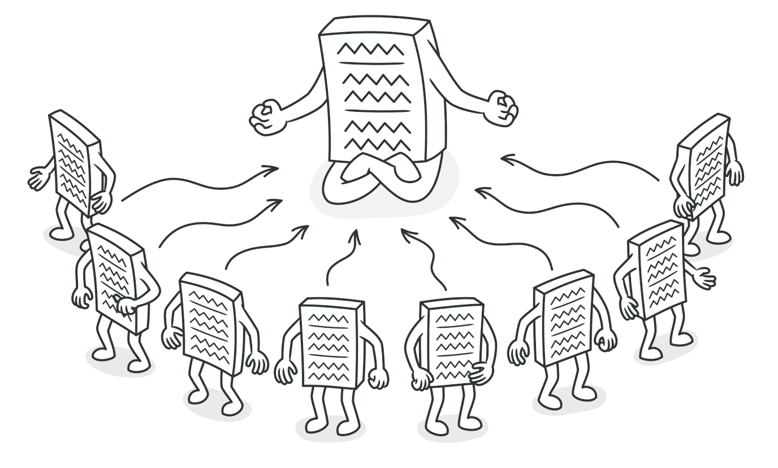
Singleton Creational Design Patterns
Lets you ensure that a class has only one instance, while providing a global access point to this instance.
link

Slide 32
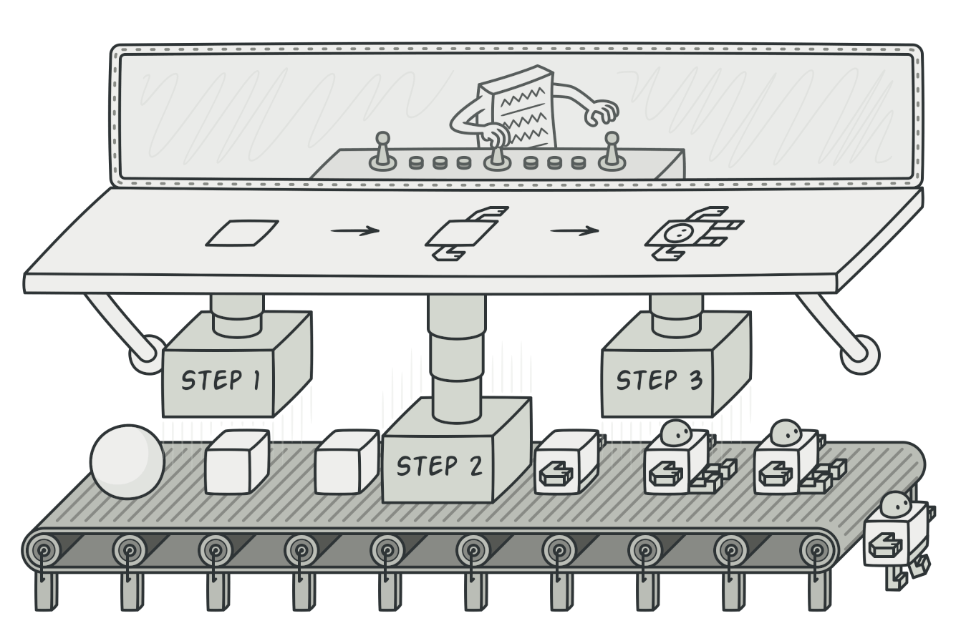
Builder Creational Design Patterns
Lets you construct complex objects step by step. The pattern allows you to produce different types and representations of an object using the same construction code.
link

Slide 33
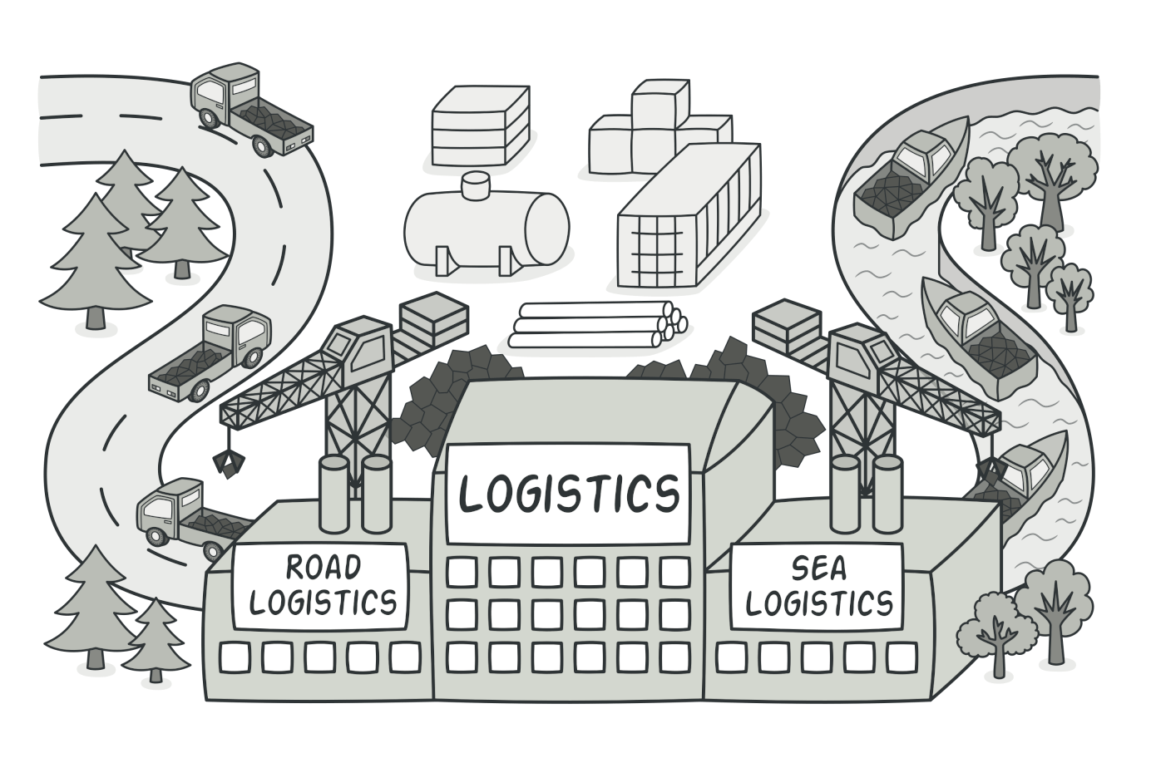
Factory Method Creational DesiGn Patterns
Provides an interface for creating objects in a superclass, but allows subclasses to alter the type of objects that will be created.
link

Slide 34
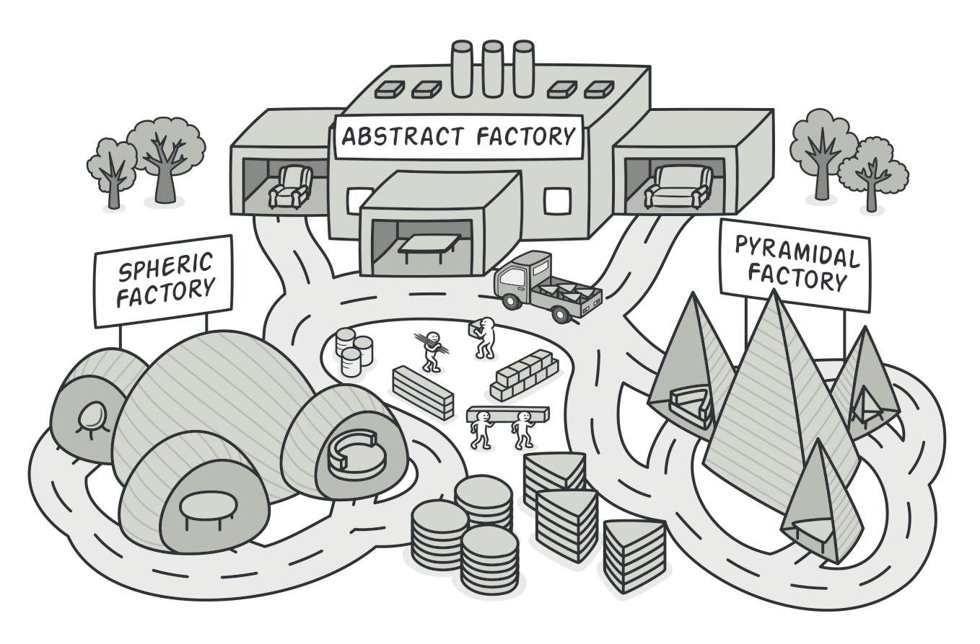
Abstract Factory Creational DesiGn Patterns
Lets you produce families of related objects without specifying their concrete classes.
link

Slide 35
roadmap - Design Patterns
Creational Design Patterns: Singleton, Builder, Factory, Abstract Factory, Prototype;
Structural Design Patterns: Adapter, Decorator, Facade, Proxy, Bridge, Composition, Flyweight;
Behavioral Design Patterns: Chain of Responsability, Command, Iterator, Observer, Strategy, Template Method, Visitor, Memento, State, Mediator.

Slide 36
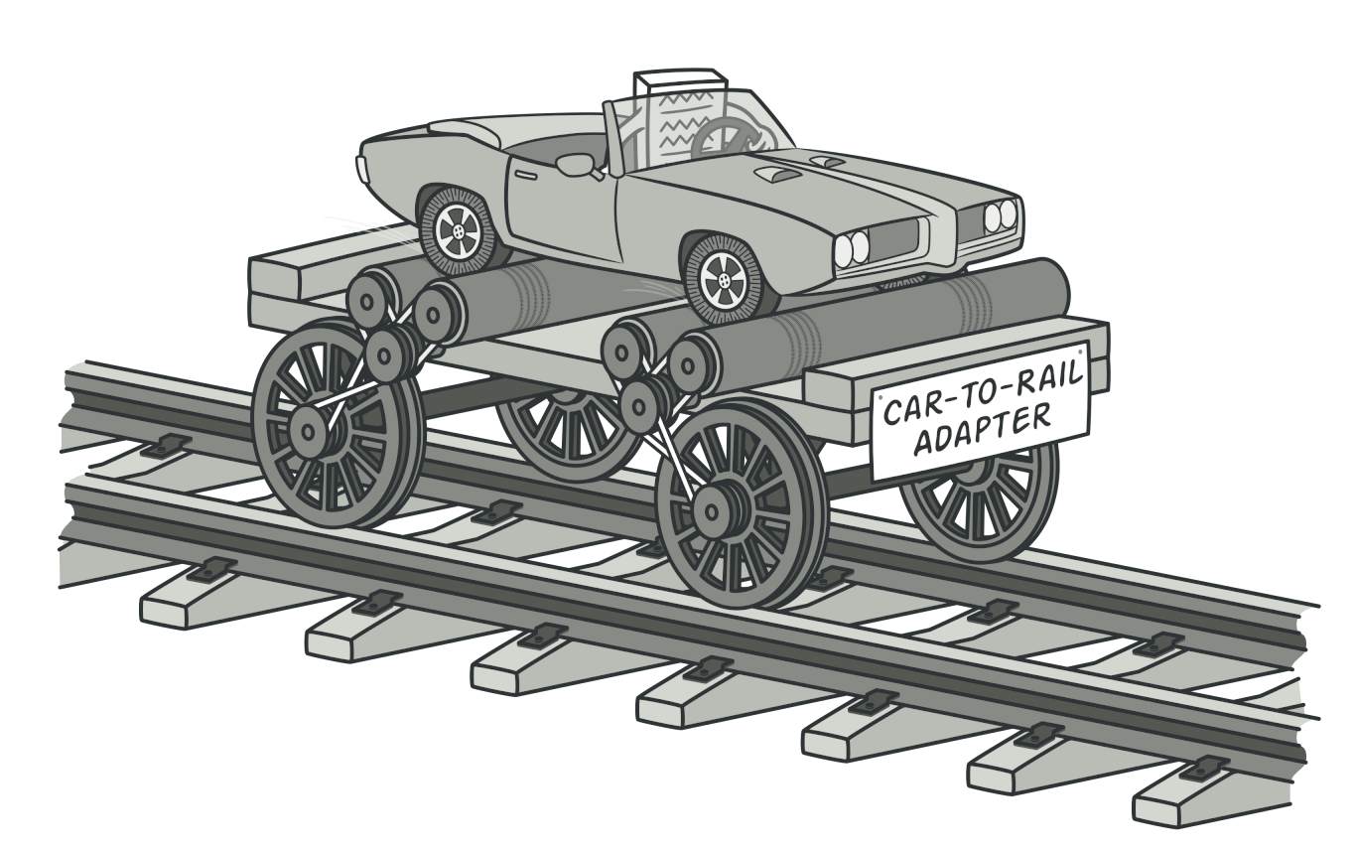
Adapter Structural Design Patterns
Provides a unified interface that allows objects with incompatible interfaces to collaborate.
link

Slide 37
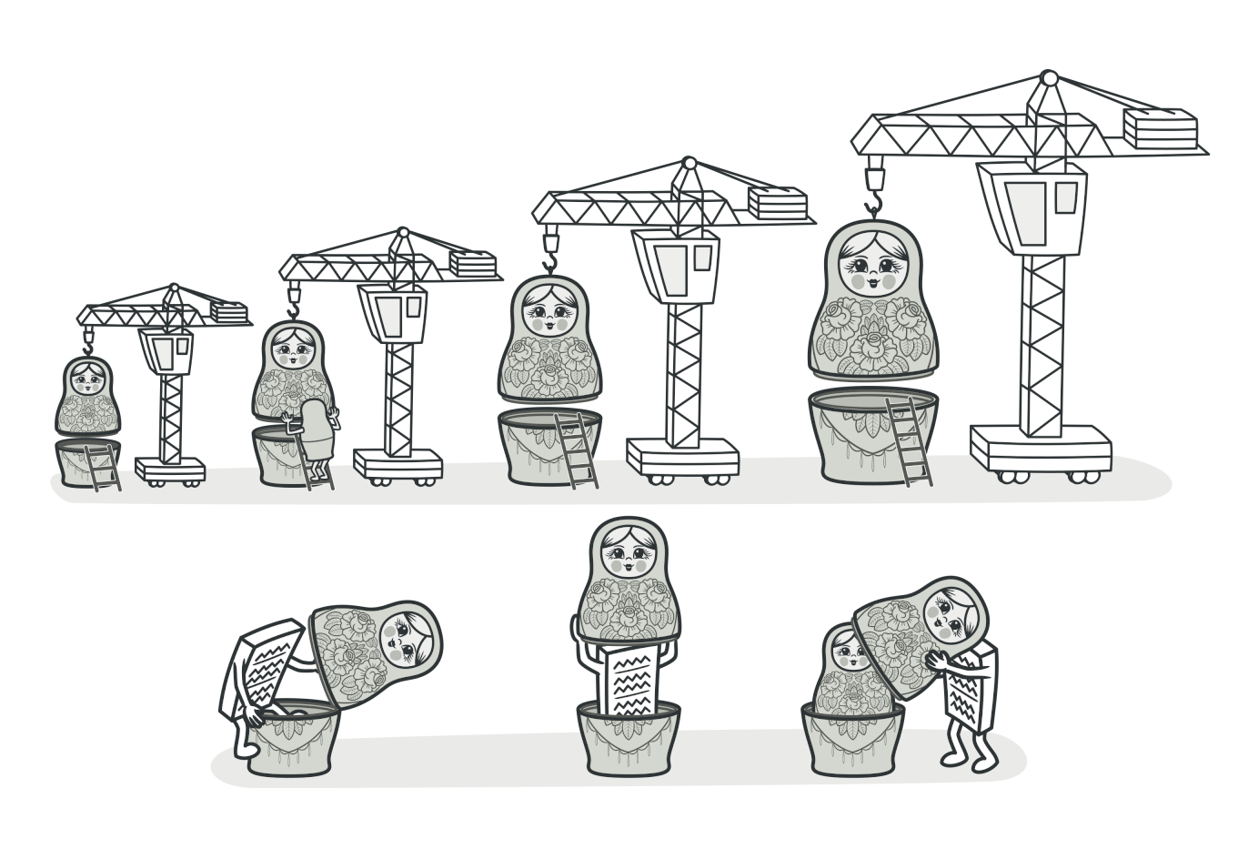
Decorator Structural Design Patterns
Lets you attach new behaviors to objects by placing these objects inside special wrapper objects that contain the behaviors.
link

Slide 38
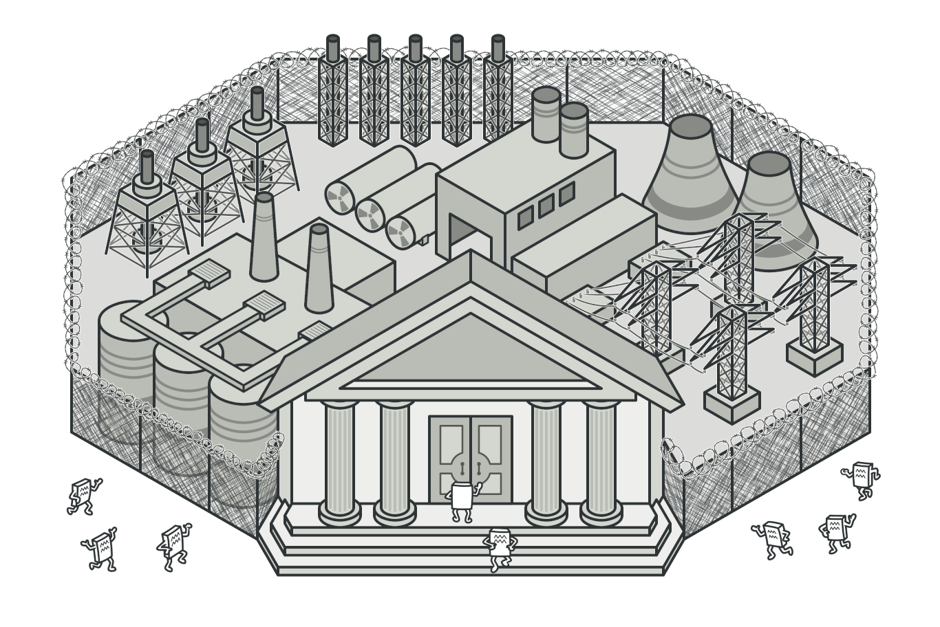
Facade Structural Design Patterns
Provides a simplified interface to a library, a framework, or any other complex set of classes.
link

Slide 39
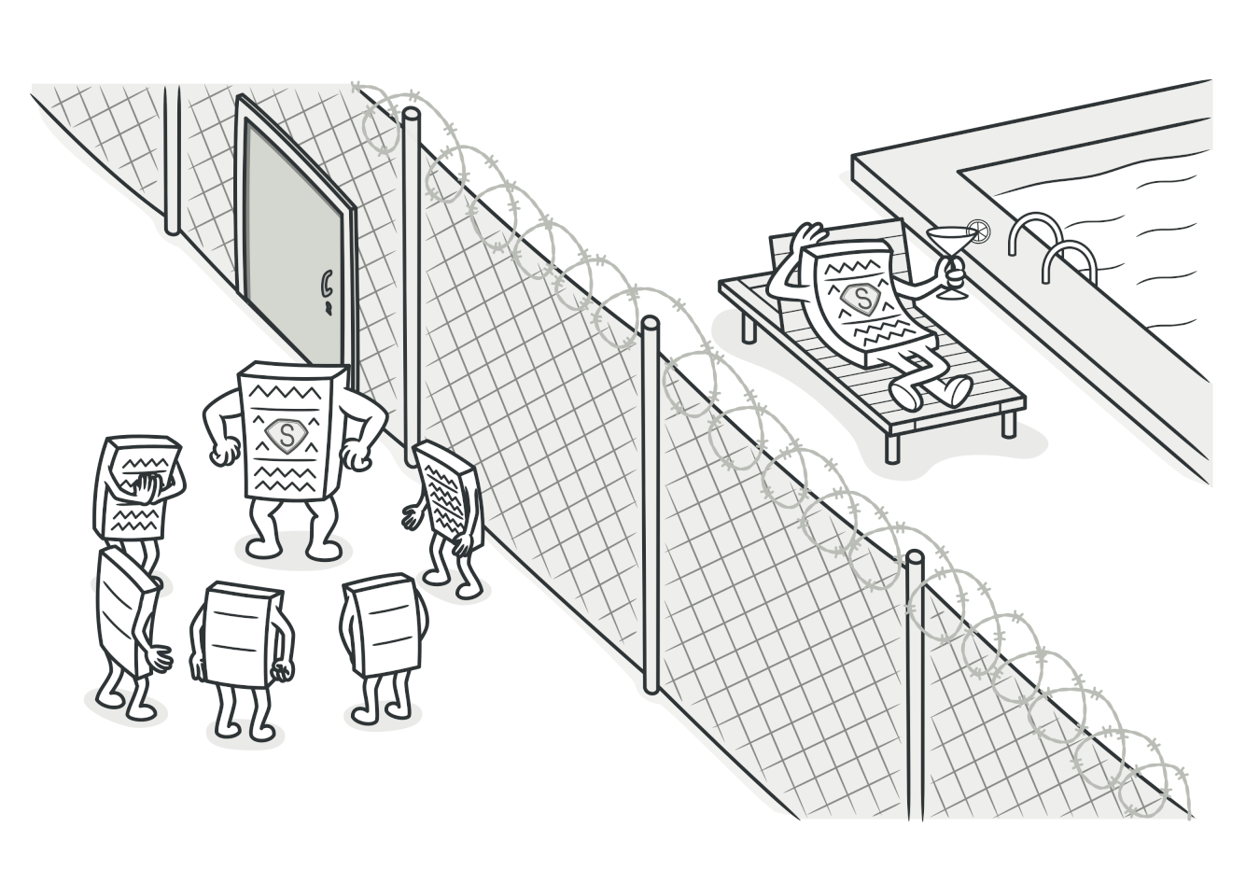
PROXY Structura Design Patterns
Lets you provide a substitute or placeholder for another object. A proxy controls access to the original object, allowing you to perform something either before or after the request gets through to the original object.
link

Slide 40
roadmap - Design Patterns
Creational Design Patterns: Singleton, Builder, Factory, Abstract Factory, Prototype;
Structural Design Patterns: Adapter, Decorator, Facade, Proxy, Bridge, Composition, Flyweight;
Behavioral Design Patterns: Chain of Responsability, Command, Iterator, Observer, Strategy, Template Method, Visitor, Memento, State, Mediator.

Slide 41
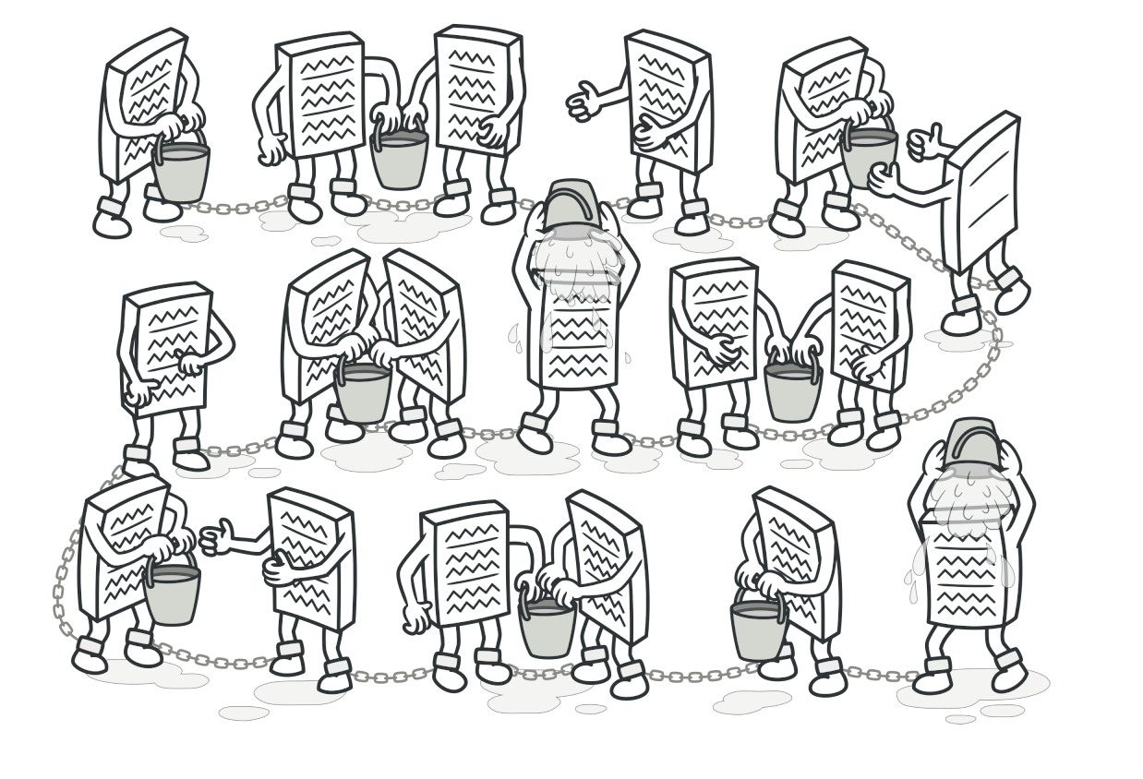
Chain of Responsability behavioral Design Patterns
Lets you pass requests along a chain of handlers. Upon receiving a request, each handler decides either to process the request or to pass it to the next handler in the chain.
link

Slide 42
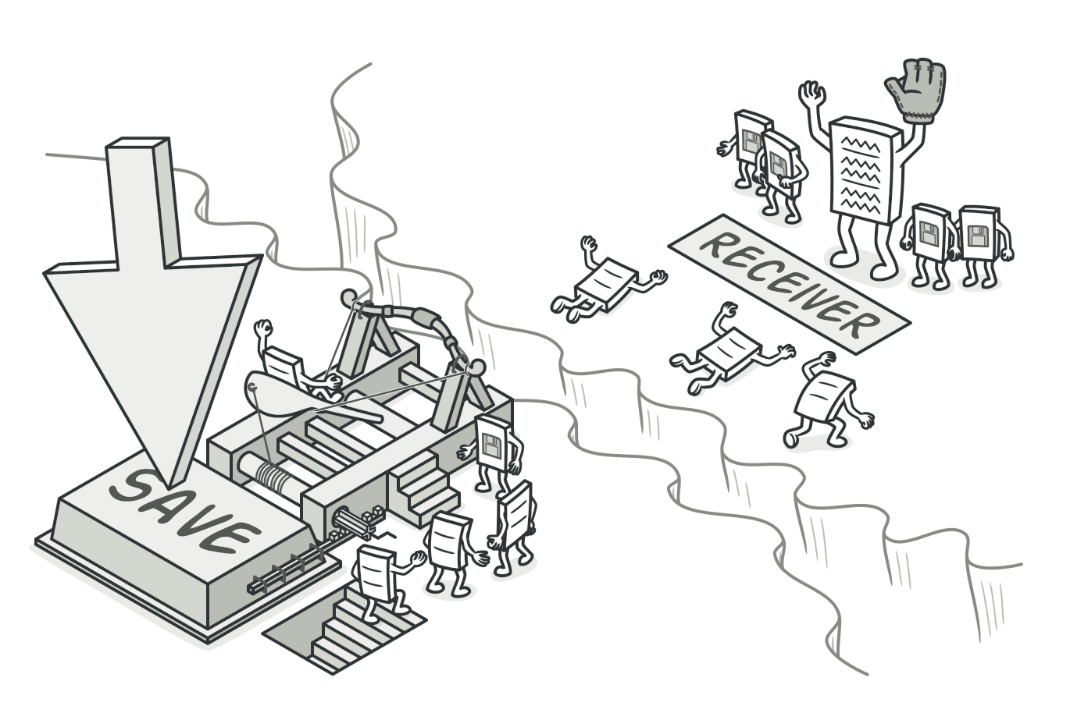
COMMAND behavioral Design Patterns
Turns a request into a stand-alone object that contains all information about the request. This transformation lets you parameterize methods with different requests, delay or queue a request's execution, and support undoable operations.
link

Slide 43
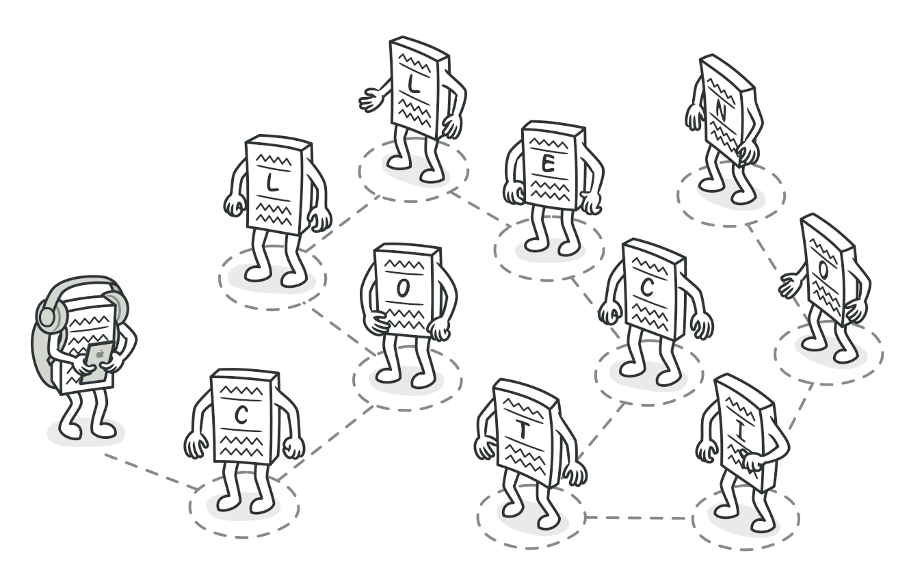
ITERATOR behavioral Design Patterns
Lets you traverse elements of a collection without exposing its underlying representation (list, stack, tree, etc.).
link

Slide 44
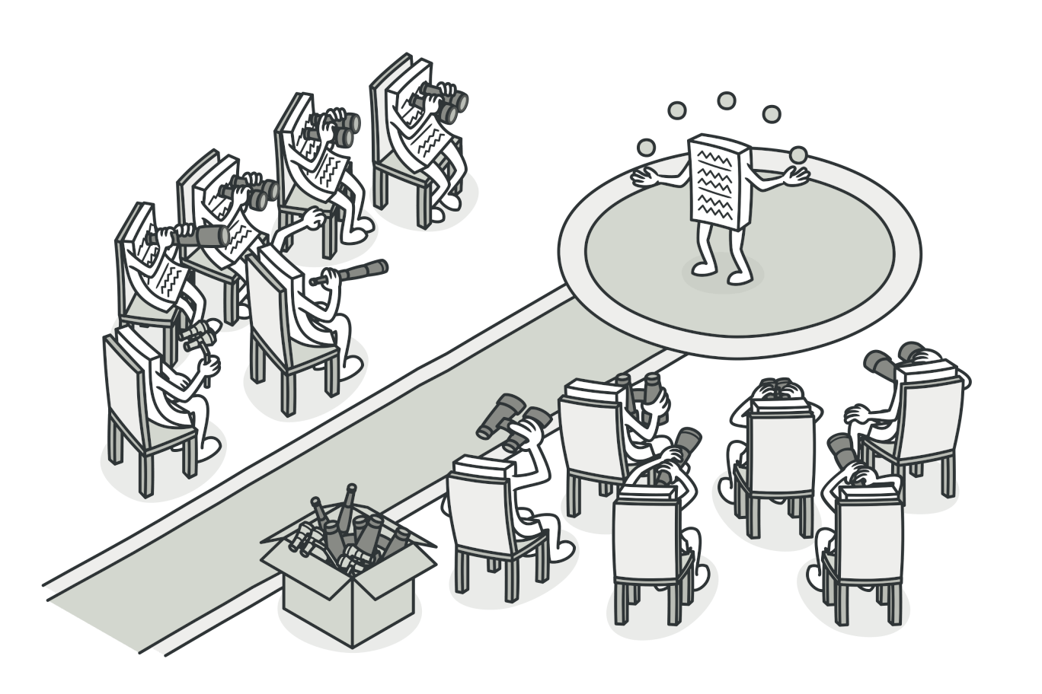
OBSERVER behavioral Design Patterns
Lets you define a subscription mechanism to notify multiple objects about any events that happen to the object they're observing.
link

Slide 45
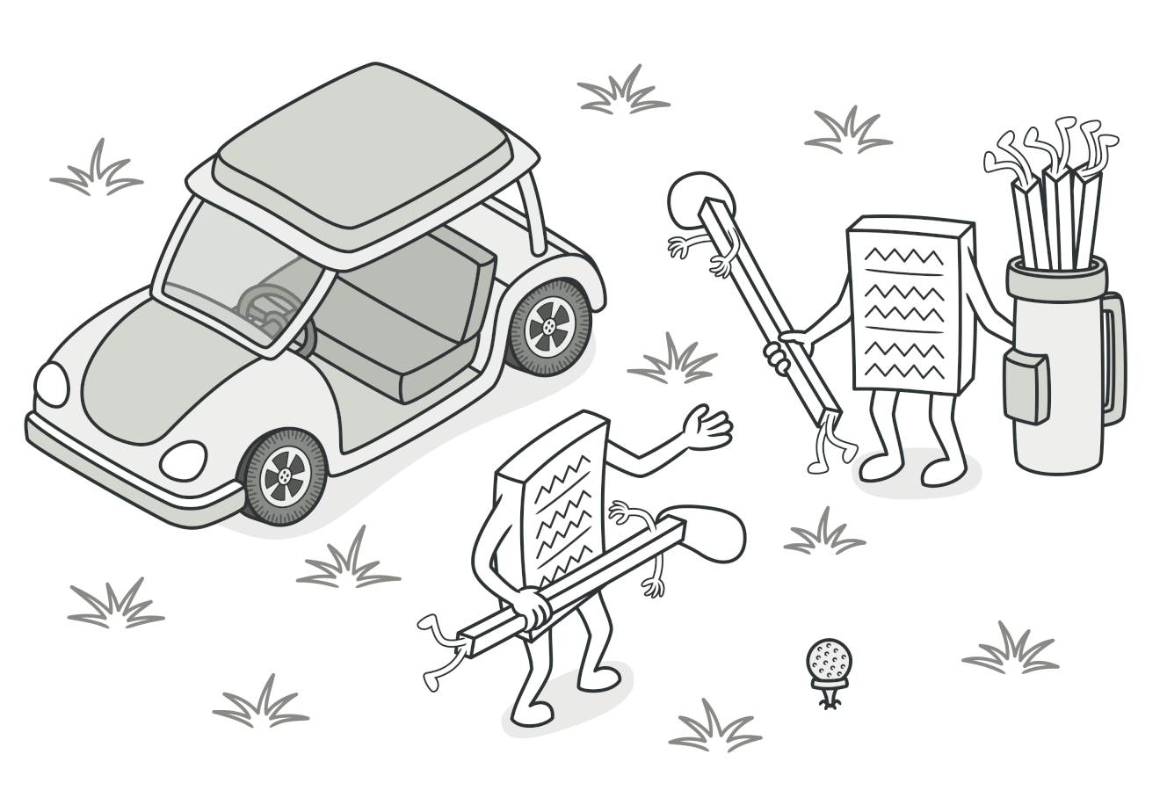
STRATEGY behavioral Design Patterns
Lets you define a family of algorithms, put each of them into a separate class, and make their objects interchangeable.
link

Slide 46
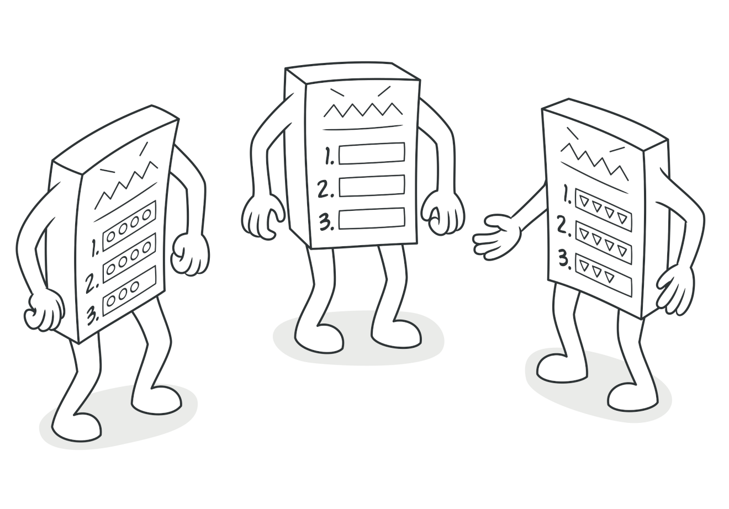
TEMPLATE METHOD behavioral Design Patterns
Defines the skeleton of an algorithm in the superclass but lets subclasses override specific steps of the algorithm without changing its structure.
link

Slide 47
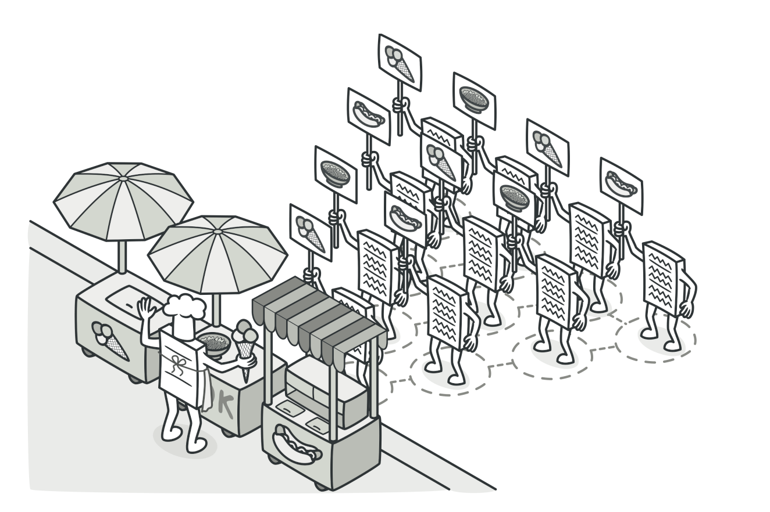
VISITOR behavioral Design Patterns
Lets you separate algorithms from the objects on which they operate.
link

Slide 48
Resources
Books:
Design Patterns: Elements of Reusable Object-Oriented Software link
Head First Design Patterns: A Brain-Friendly Guide link
Learning Platforms:
Pluralsight: https://www.pluralsight.com/paths/design-patterns-in-java
Coursera: https://www.coursera.org/learn/design-patterns
Sites:
Beldung - link
Refactoring.Guru – link
GitHub
git clone https://github.com/laurentiu-miu/design-patterns.git

